Slide 1
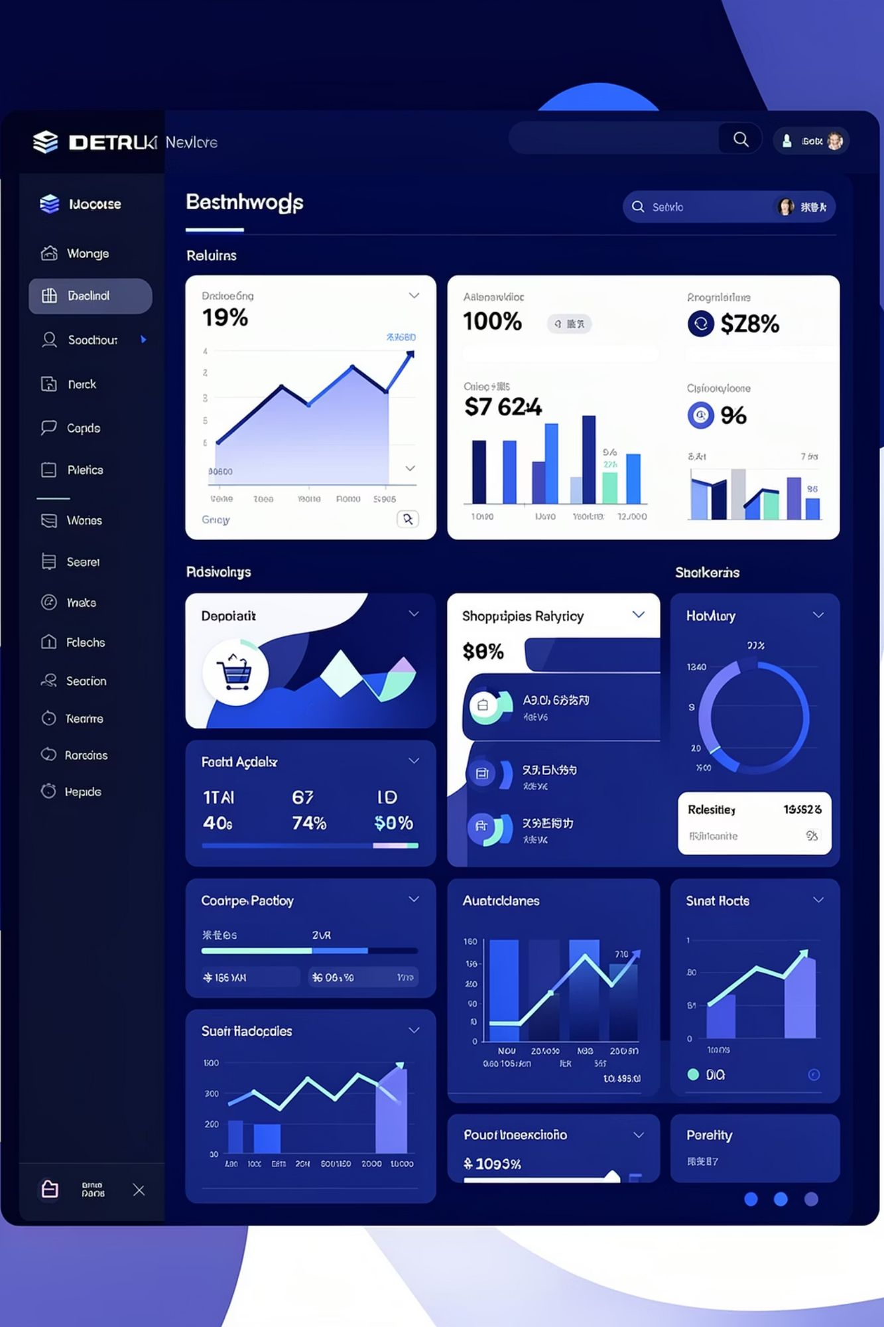
Customer Shopping Behavior Analysis
Uncovering insights from 3,900 purchases to guide strategic business decisions through data-driven analysis of spending patterns, customer segments, and product preferences.

Slide 2

DATASET OVERVIEW
Understanding Our Data Foundation
3,900
18
37
Total Purchases
Data Columns
Missing Values
Transactions analyzed
Feature variables
In Review Rating only
Key Data Categories
Customer demographics: Age, Gender, Location, Subscription Status
Purchase details: Item, Category, Amount, Season, Size, Color
Shopping behavior: Discounts, Promo Codes, Previous Purchases, Frequency, Review Rating, Shipping Type

Slide 3
Data Preparation & Cleaning in Python
01
02
03
Data Loading & Exploration
Missing Data Handling
Feature Engineering
Imported dataset using pandas, checked structure with df.info() and summary statistics with .describe()
Imputed 37 missing Review Rating values using median rating of each product category
Created age_group column by binning customer ages and purchase_frequency_days from purchase data
04
05
Data Consistency
Database Integration
Standardized columns to snake_case, verified discount_applied and promo_code_used redundancy, dropped promo_code_used
Connected to PostgreSQL and loaded cleaned DataFrame for SQL analysis

Slide 4
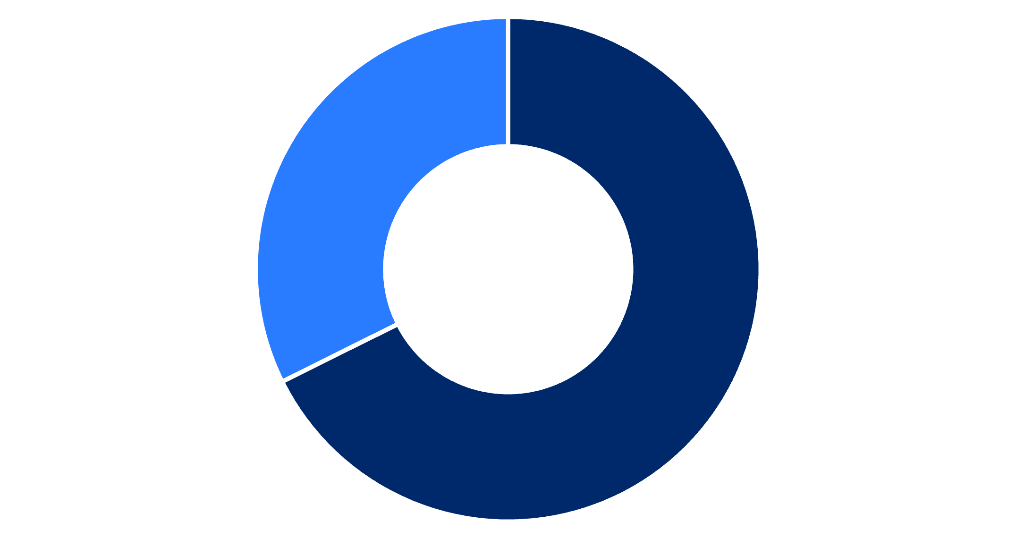
REVENUE ANALYSIS
Gender-Based Revenue Insights
Key Finding
Male customers generate more than double the revenue of female customers, representing 68% of total revenue versus 32%.
This significant disparity suggests opportunities for targeted marketing campaigns to increase female customer engagement and spending.
Male
Female

Slide 5
Top-Performing Products & Customer Segments
Highest-Rated Products
77%
77%
76%
Gloves
Sandals
Boots
3.86 average rating
3.84 average rating
3.82 average rating
76%
76%
Hat
Skirt
3.80 average rating
3.78 average rating

Slide 6
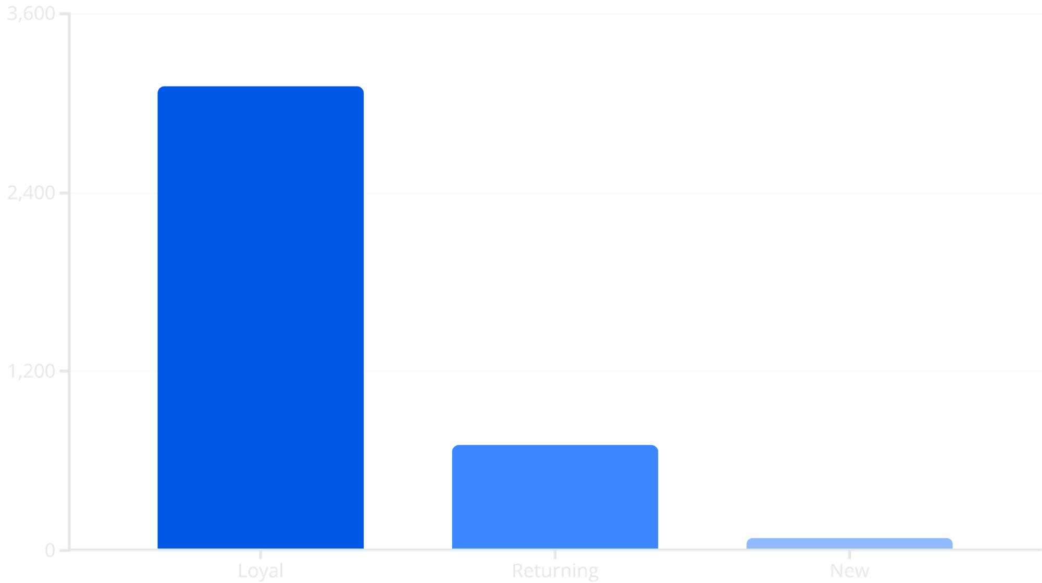
Customer Loyalty Segmentation
Loyalty Dominates
80% of customers are classified as Loyal based on purchase history, demonstrating strong customer retention.
Focus on converting the 18% Returning segment into Loyal customers through targeted engagement programs.

Slide 7



SUBSCRIPTION ANALYSIS
Subscription Impact on Revenue
Subscribers
Non-Subscribers
Repeat Buyers
1,053 customers
2,847 customers
3,476 customers with 5+ purchases
Average spend: $59.49
Average spend: $59.87
958 are subscribers
Total revenue: $62,645
Total revenue: $170,436
2,518 are non-subscribers
While non-subscribers generate more total revenue due to higher volume, there's significant opportunity to convert repeat buyers into subscribers with exclusive benefits.

Slide 8
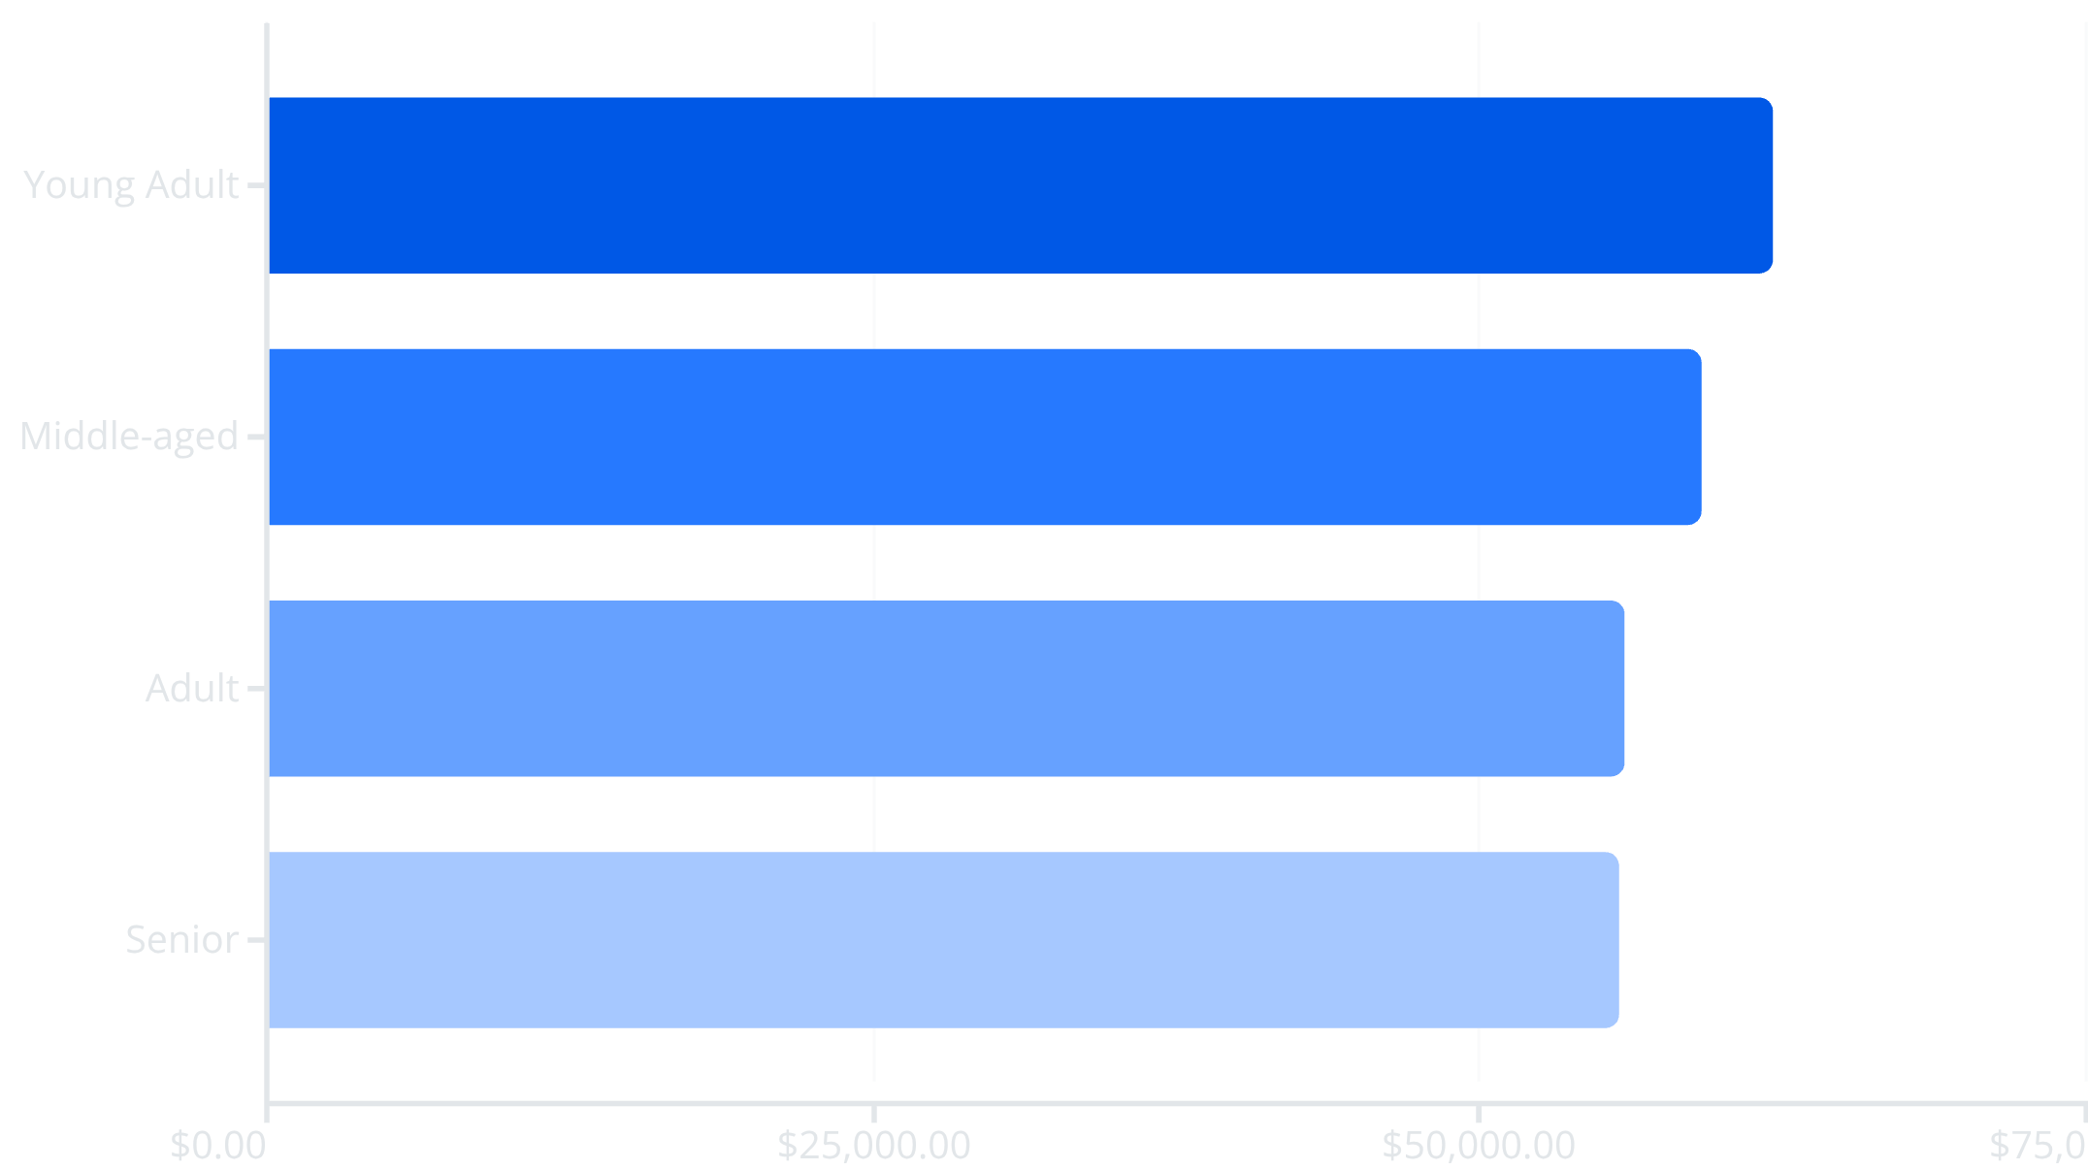
Revenue Distribution by Age Group
Balanced Demographics
Revenue is relatively evenly distributed across age groups, with Young Adults leading at $62,143.
The consistency across segments suggests broad market appeal, though targeted campaigns for Young Adults could maximize the highest-performing demographic.

Slide 9
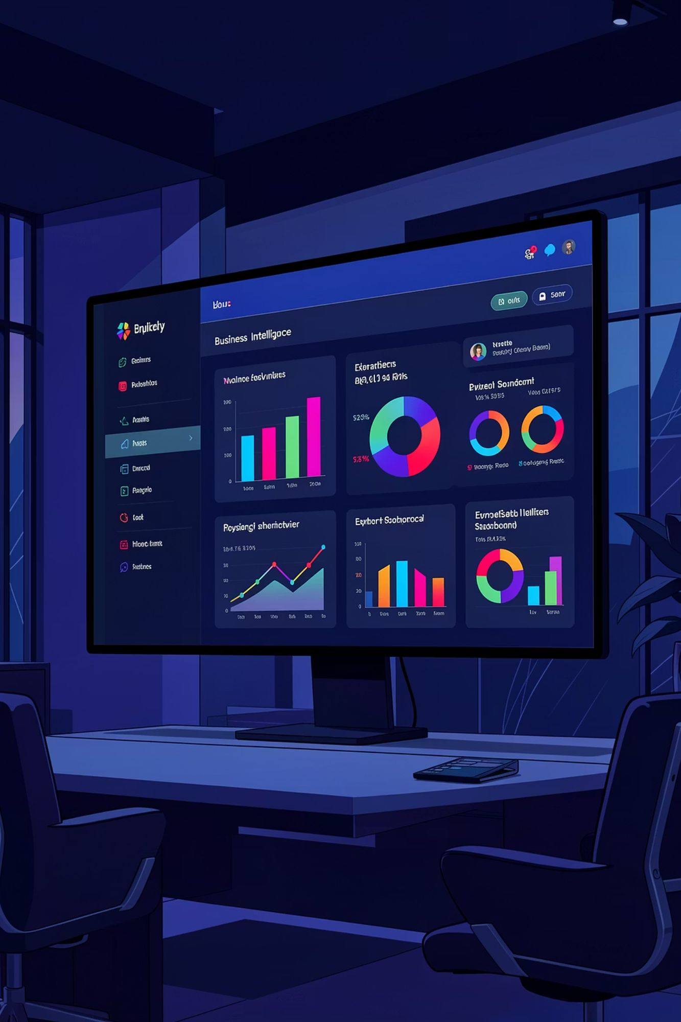
Power BI Dashboard Overview
Our interactive Consumer Behavior Dashboard provides real-time insights with dynamic filtering capabilities across subscription status, gender, category, and shipping type.
3,900
$59.76
3.75
Total Customers
Avg Purchase Amount
Avg Review Rating
73%
Non-Subscribers
The dashboard reveals Clothing dominates with $110K revenue and 1.8K sales, followed by Accessories at $80K revenue. Young Adults lead revenue generation across all age groups.

Slide 10
STRATEGIC RECOMMENDATIONS
Key Business Recommendations
1
Boost Subscriptions
Promote exclusive benefits and perks to convert the 73% non-subscriber base, especially targeting repeat buyers with 5+ purchases.
2
Customer Loyalty Programs
Reward the 701 Returning customers to accelerate their transition into the Loyal segment through personalized incentives.
3
Review Discount Policy
Balance promotional sales boosts with margin control, as 839 customers used discounts while spending above average.
4
Product Positioning
Highlight top-rated products (Gloves, Sandals, Boots) and best-sellers in Clothing category in marketing campaigns.
5
Targeted Marketing
Focus efforts on Young Adults and express-shipping users who demonstrate higher engagement and spending patterns.

